Slide 1
Segmentation and Forecasting of Maritime Cereal Trade for Food Security: A Bilateral Gravity–Machine Learning Framework
Presented by
Bima surya WICAKSANA

Slide 2
Why This Study Matters
Motivation
80% of Agri-food & Cereal Trade carried out by sea.
Cereals and staples are the backbones of global food security.
Cereals Import dependency on Sea.
Freight Rate and other cost volatility on Sea Transport/trade cost.
Research Gap
On Maritime Forecasting Literature:
➡️ Aggregated Output, and Linear Input.
On Food security/ Trade Literature:
➡️ Focuses on vulnerability and dependency indicators, and few of general trade modelling.
Missing:
➡️ Bilateral forecasting of maritime trade and transport with modelling variables related to food commodities.

Slide 3
Research Question and Output
How can bilateral maritime trade volumes and transport costs for essential cereal commodities be structurally modelled and forecasted to assess exposure risks in seaborne food trade?
Methodological
A Bilateral gravity-inspired food security and maritime transport model
Standard Econometric model and Machine learning model
Empirical
Identification of connectivity and cost elasticities in cereal trade
Forecast projections for 2025–2030
Analytical
Correlation of Food demand-supply as proxy for trade and maritime transport
Assessment of high-dependency trade corridors exposure to maritime cost volatility

Slide 4
Data and Segmentation Methodology
Data Sources
UNCTAD bilateral transport cost and trade + Country Panel data (GDP, population, Distance) + Product Supply-demand / FAO food balance (Calorific needs + Production) + Transport Related (Freight Rate and LBSCI)
Data Preparation
Combine Data Product x Origin Country x Destination Country, ensure most of the observed data have panel data of Country economies, Product Supply-Demand, and Transport proxies.
Segmentation
Commodity: cereal focus, group based on HS header 10, consist of 8 Products
Country: import dependency & maritime reliance
Corridor: concentration & exposure

Slide 5
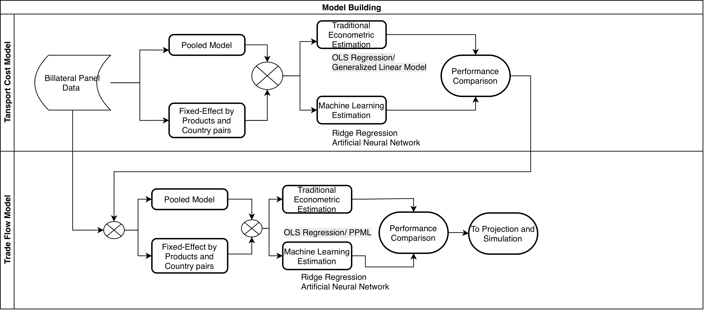
Forecast and Projection Methodology

Slide 6
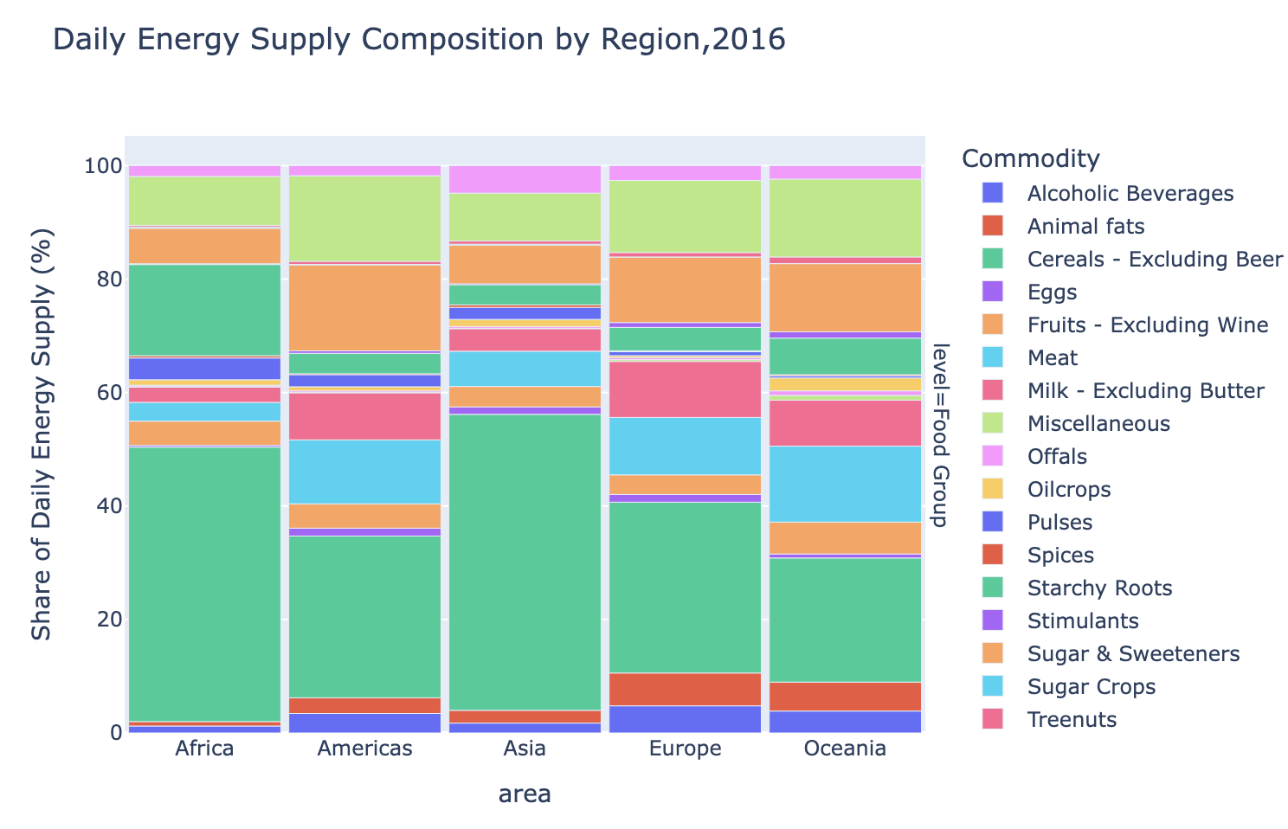
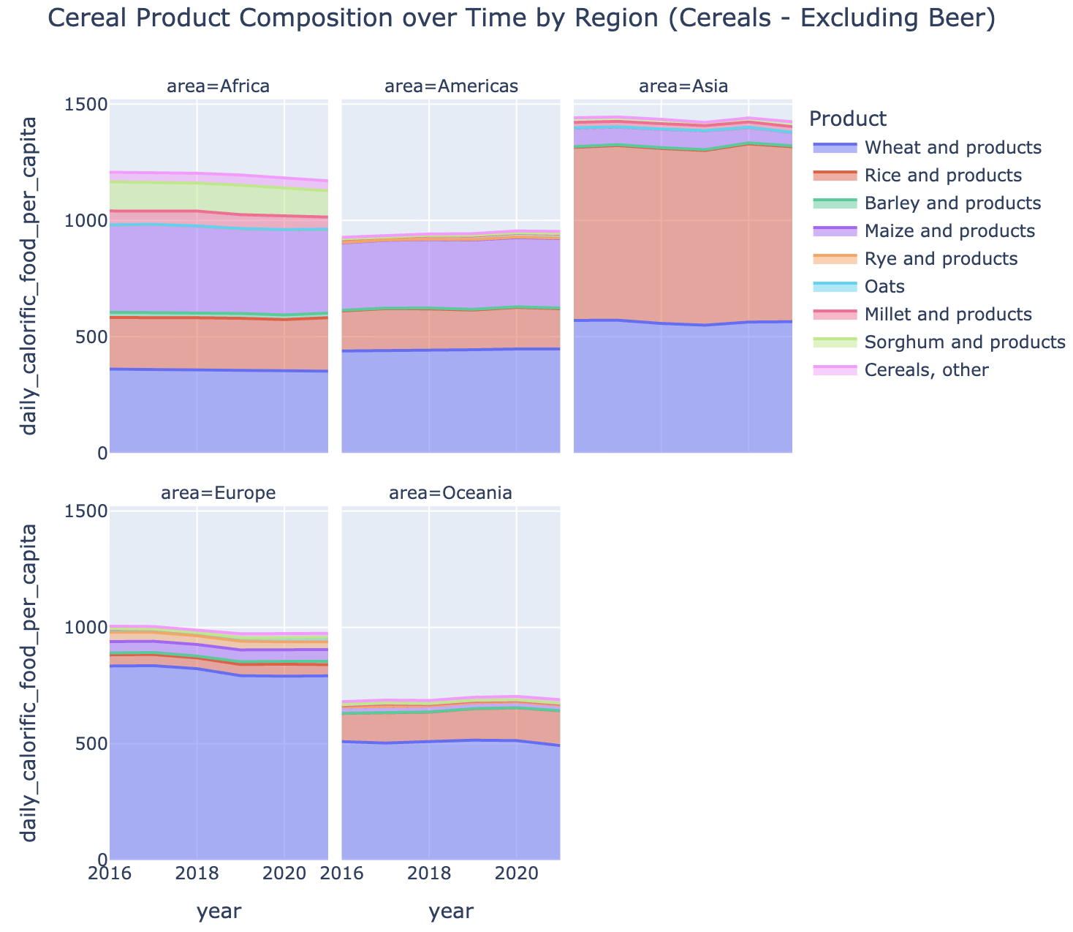
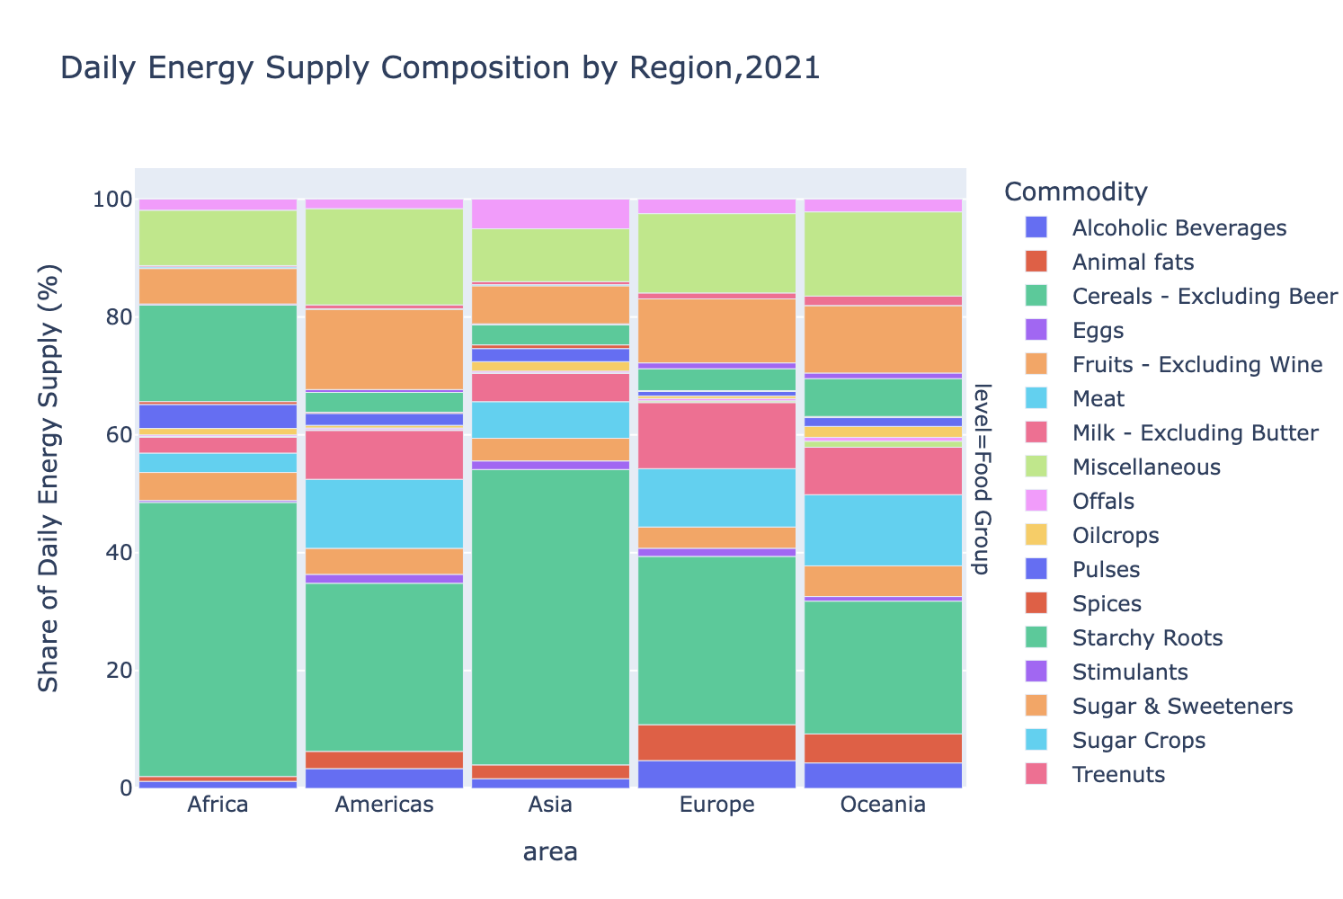
Important Commodities to Calorific Need
This justify more Cereals groups to be focussed in this study

Slide 7
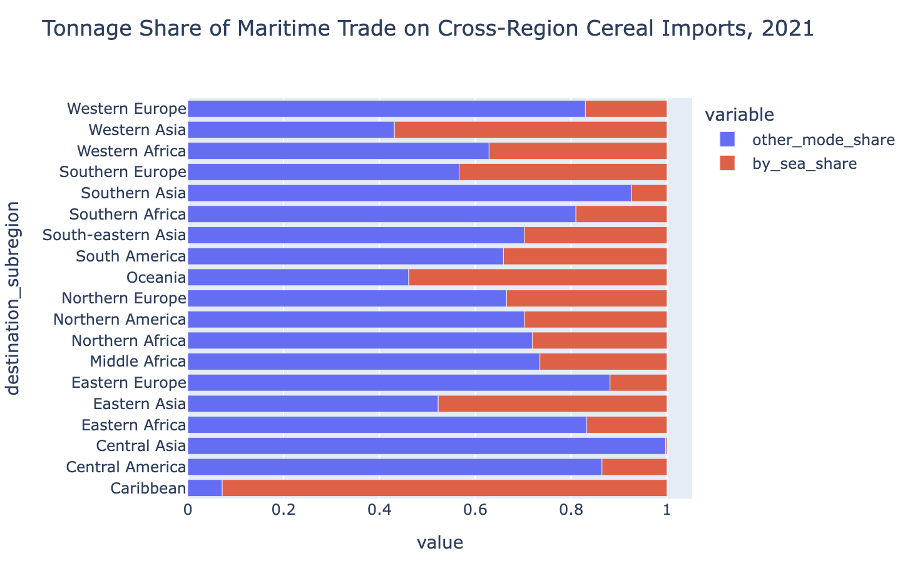
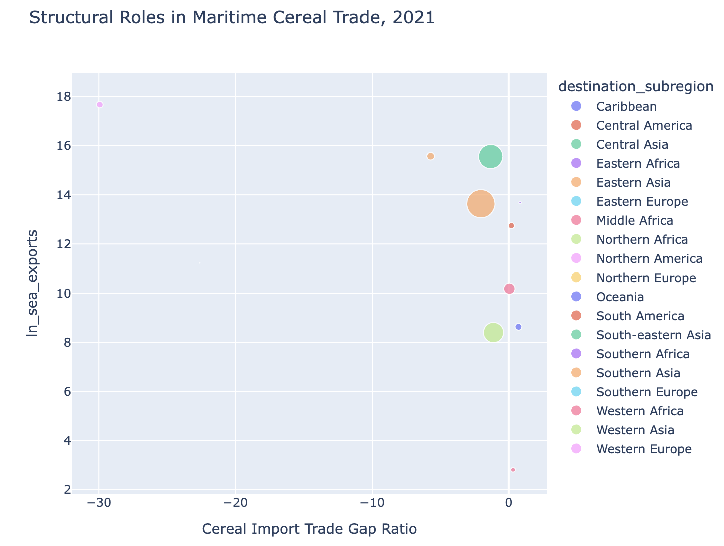
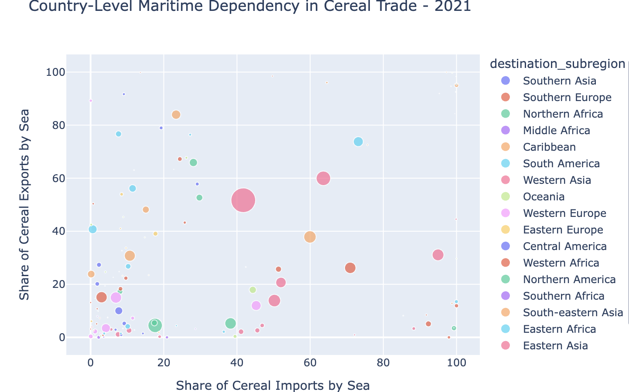
Maritime Importance in the Cereal Trade structure

Slide 8
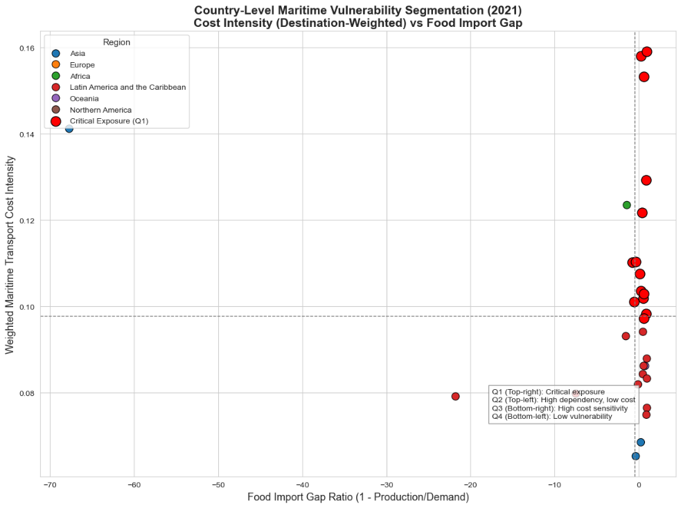
Segmentation: Country Vulnurability
Indicator 1, Import Gap
Indicator 2, Cost Intensity (Transport cost per FOB value)
Clustering country to quadrant

Slide 9
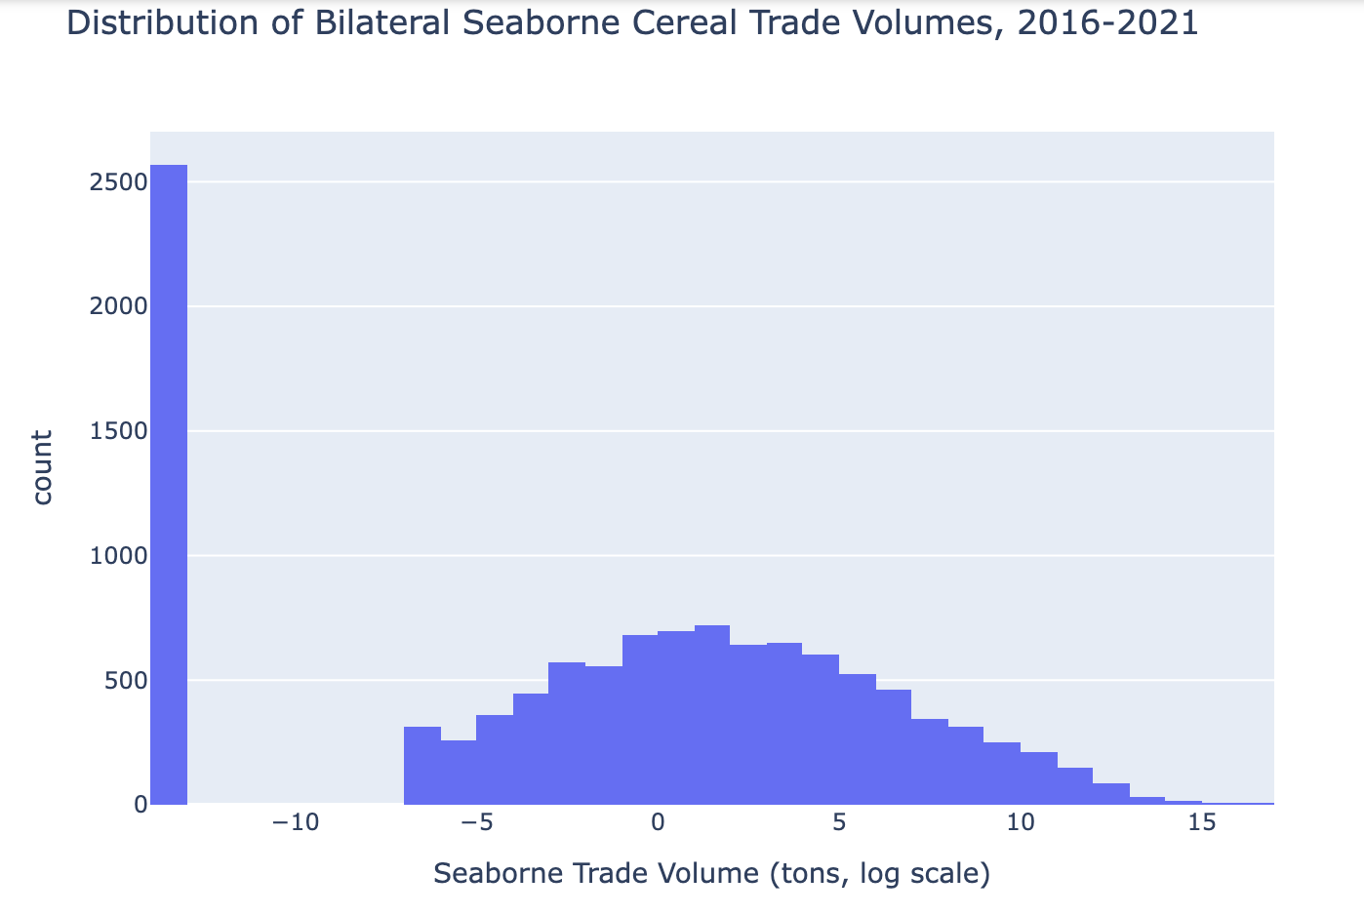
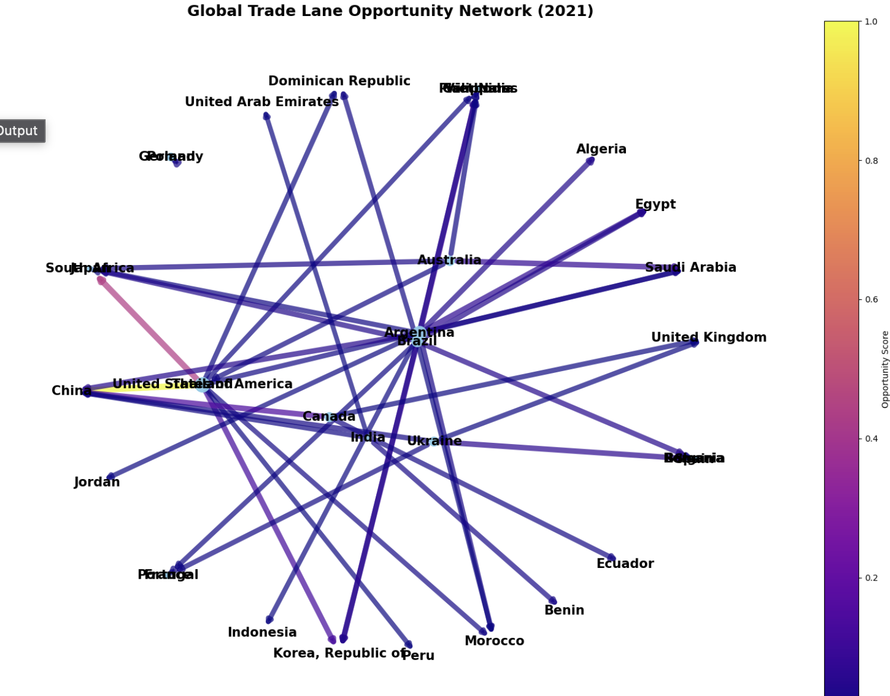
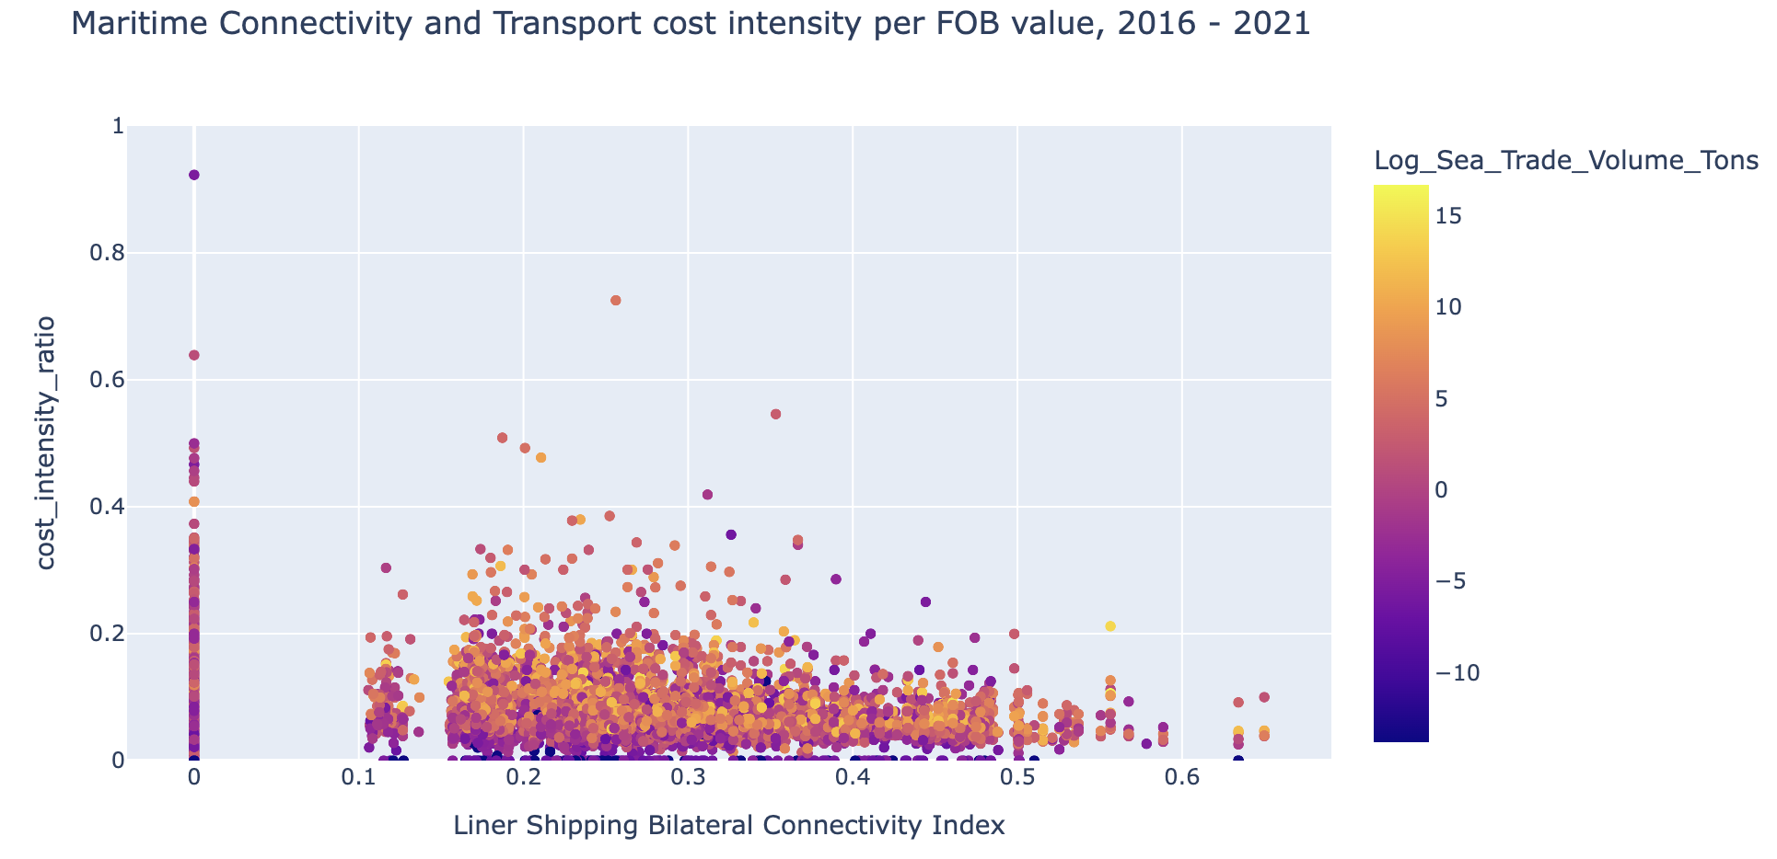
Segmentation: Corridor Opportunity

Slide 10
Transport Cost Forecast Model
Econometric Model (Ordinary Least Square Regression)
Pooled Configuration Model
variable | OLS
 | coefficient | p_value
ln_dist | 0.147368 | 0.000
conn_ij | -0.143170 | 1.000
comp_ij | -0.143170 | 1.000
ln_gdp_o | -0.000569 | 0.881
ln_gdp_d | 0.021149 | 0.000
ln_fbx | 0.245669 | 0.000
bulk_share | -3.846798 | 0.000
ln_bdi_x_bulk | 0.171482 | NaN
ln_dist_x_bulk | 0.069025 | 0.161
conn_x_bulk | 0.307273 | 0.000
 | R2 | RMSE | MAPE(%) | Bias | ExtremeResiduals | ExtremeShare(%) | N_obs
OLS | 0.2069 | 0.9781 | 22.1876 | -0.0000 | 8456.0 | 18.0726 | 46789.0
Fixed Effect Configuration Model
variable | coefficient | p_value
bulk_share | -2.178 | 0.099
conn_ij | -0.087 | 0.296
conn_x_bulk | 0.128 | 0.099
ln_bdi_x_bulk | 0.092 | 0.074
ln_dist | 0.219 | 0.006
ln_dist_x_bulk | 0.045 | 0.216
ln_fbx | 0.224 | 0.004
ln_gdp_d | 0.147 | 0.107
ln_gdp_o | 0.353 | 0.065
commodity | R2 | RMSE | MAPE(%) | Bias | ExtremeResiduals | ExtremeShare(%)
1007 | 0.623 | 1052.353 | 63.840 | -116.059 | 114 | 5.295
1002 | 0.602 | 822.361 | 54.632 | -66.246 | 49 | 3.412
1001 | 0.583 | 157.832 | 46.392 | -11.931 | 160 | 2.804
1005 | 0.557 | 928.733 | 84.240 | -95.000 | 842 | 7.820
1003 | 0.536 | 370.625 | 80.959 | -39.410 | 174 | 3.872
1004 | 0.516 | 378.943 | 56.963 | -49.744 | 116 | 3.775
1008 | 0.471 | 232.130 | 74.097 | -37.840 | 277 | 5.203
1006 | 0.428 | 393.642 | 60.474 | -34.685 | 390 | 2.819

Slide 11
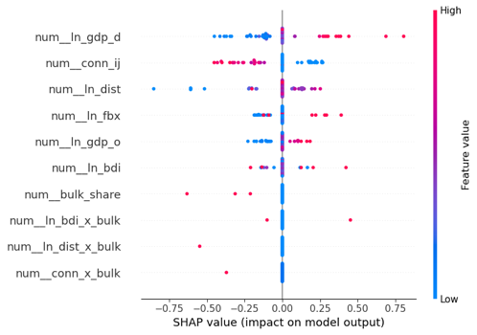
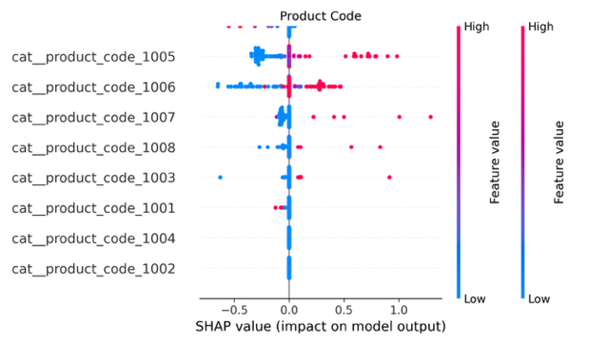
Transport Cost Forecast Model
Machine Learning Model (Artificial Neural Network)
Machine learning is used to increase robustness of nonlinear relation and heterogeneity of bilateral data explanation
Robustness Evaluation
Interpretation
R2 | RMSE | MAE | MAPE (%) | Extreme Errors (>30%) | Extreme Share (%)
0.8333 | 0.4485 | 0.3062 | 8.92 | 1187 | 2.54
Artificial Neural Network best of its interpretability compare to traditional model and handling complex panel data ->
Other model evaluated: Ridge Regression

Slide 12
Trade Volume Forecast Model
Econometric Model
The study explored two models, the OLS regression and the Pseudo-Poisson Maximum that is more robust and explicable, supported by latest research results.
 | PPML Pooled |  | Product level Fixed Effect |  | Countries Fixed Effect
term | coef | sig | coef | sig | coef | sig
const | -6.283245 | *** | -6.141142 | *** | 7.556117
Origin GDP | 0.014931 | ** | -0.005818 |  | -0.224588
Destination GDP | 0.269107 | *** | 0.261663 | *** | -0.014498
Distance | 0.202176 | *** | 0.280375 | *** | -0.523133 | ***
cepii_contig | 0.374009 | ** | 0.532806 | *** | -0.010638
cepii_comlang_ethno | -0.314717 | *** | -0.429247 | *** | -0.476032 | ***
cepii_wto_o | 0.423267 | * | 0.560496 | ** | -0.957258
cepii_wto_d | -0.371407 | * | -0.335851 | * | 1.228137 | ***
cepii_fta_wto | 0.359001 | *** | 0.342309 | *** | 0.610227 | ***
cost_per_ton_seamodes | 0.057826 | *** | 0.068518 | *** | 0.076636 | ***
lsbci | 1.430419 | *** | 1.517142 | *** | 3.771242 | ***
origin production qty | 0.650876 | *** | 0.618926 | *** | 0.761669 | ***
Destination production qty | 0.000541 |  | -0.019099 | ** | -0.032358 | ***
Origin Daily Calorific Food | -0.057533 | *** | -0.041713 | *** |  | ***
Destination Daily Calorific Food | 0.068177 | *** | 0.080007 | *** |  | ***
Key Insight | Pooled | Product FE | OD FE
Distance elasticity | Unexpectedly + | Still + | Corrected to −
Transport cost | Low but + | Still + | Still +
LSBCI | Significant + | + | Very strong +
Production (Origin) | Strong + | Strong + | Strong +
Caloric need (Origin) | Negative | Negative | Negative
Caloric need (Destination) | Positive | Positive | Positive
 | pooled | product fixed effect | origin-destination fixed effect
RMSE | 1.85E+05 | 1.82E+05 | 1.58E+05
MAE | 2.41E+04 | 2.37E+04 | 1.91E+04
MAPE (%) | 2.07E+07 | 2.24E+07 | 4.49E+06
Bias | -8.72E-10 | -9.04E-10 | -8.77E-10
Extreme >30% (%) | 80.49 | 80.24 | 79.12
R2 | 0.35 | 0.38 | 0.67
Adj R2 | 0.35 | 0.38 | 0.67

Slide 13
Trade Volume Forecast Model
Machine Learning Model
The study explored several models (ARIMA, Neural Network, Decision Tree), Feed Forward Neural network is more fit to observed data structure and characteristic.
rank | variable | Significancies
1 | origin_production_qty | 0.908393
2 | cost_per_ton_seamodes | 0.673463
3 | cepii_fta_wto | 0.281233
5 | Destination_GDP | 0.259637
8 | lsbci | 0.206997
9 | destination_production_qty | 0.204989
16 | Origin_Daily_Calorific_Food | 0.152399
23 | cepii_wto_o | 0.108604
25 | cepii_comlang_ethno | 0.092631
29 | cepii_contig | 0.080712
33 | cepii_wto_d | 0.063990
34 | Destination_Daily_Calorific_Food | 0.058310
39 | Origin_GDP | 0.047187
Model | ANN
R2 | 0.8757
RMSE | 1.1657
MAE | 0.7619
MAPE (%) | 36.13
Extreme Errors (>30%) | 8543
Extreme Share (%) | 14.28
Machine Learning Models for both Transport Cost and Trade Volume overweight Econometric / Traditional Models

Slide 14
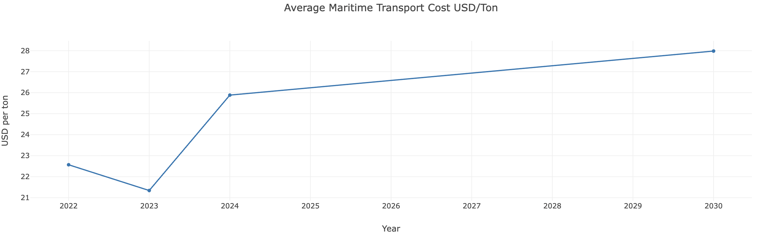
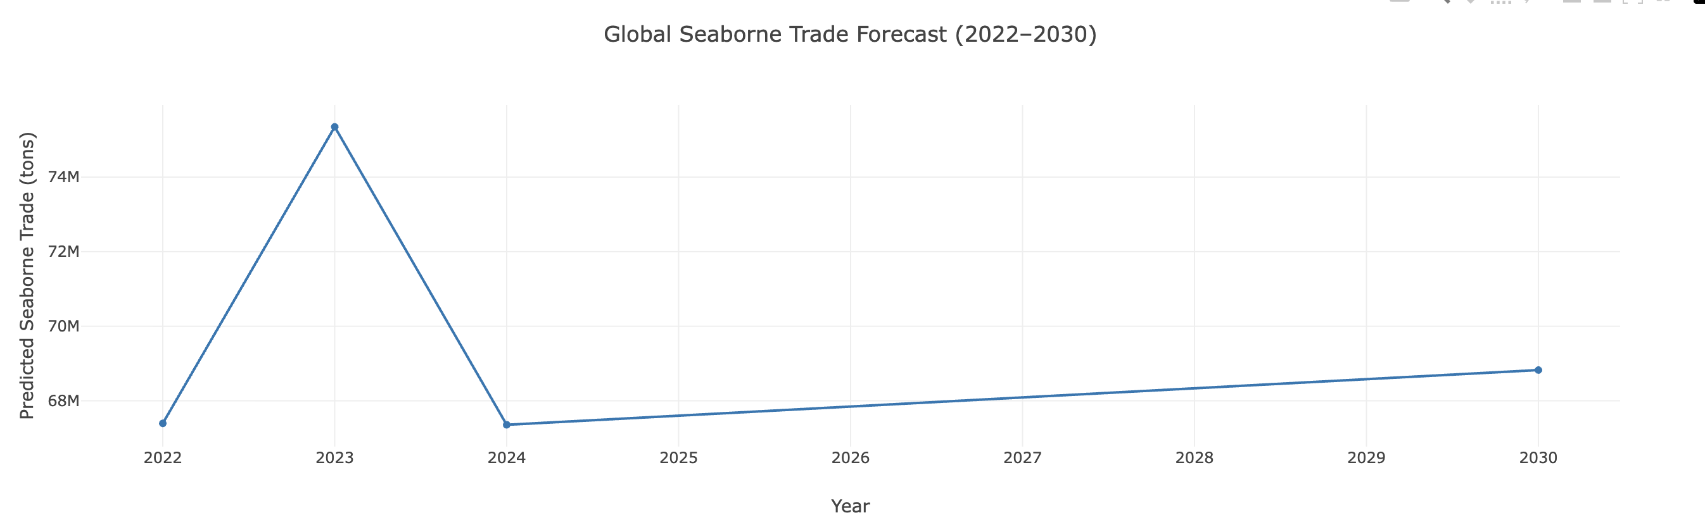
Future Forecast Projection - Baseline
Model Trained using Data 2015-2021
Variable | Assumption
GDP | Constant annual growth (historical average) 1.6% GDP per cap and 1.3% Population growth
Freight rates | Stable at 2024 level
Connectivity (LSBCI) | Fixed
Distance | Fixed
Production | Fixed
Caloric demand | Fixed
Reconstruction the 2022-2024 Data
Baseline assumption
Projection for 2025-2030

Slide 15
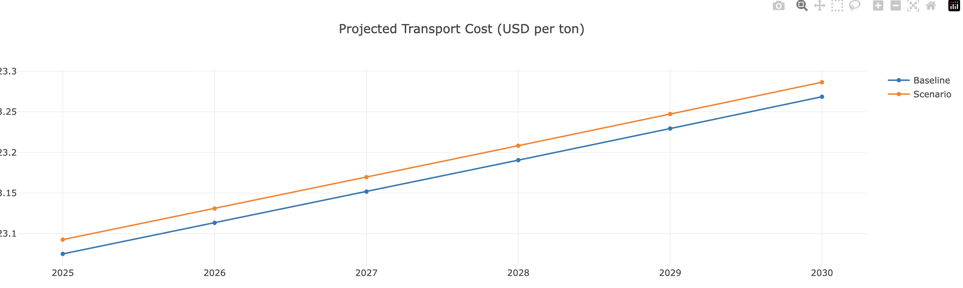
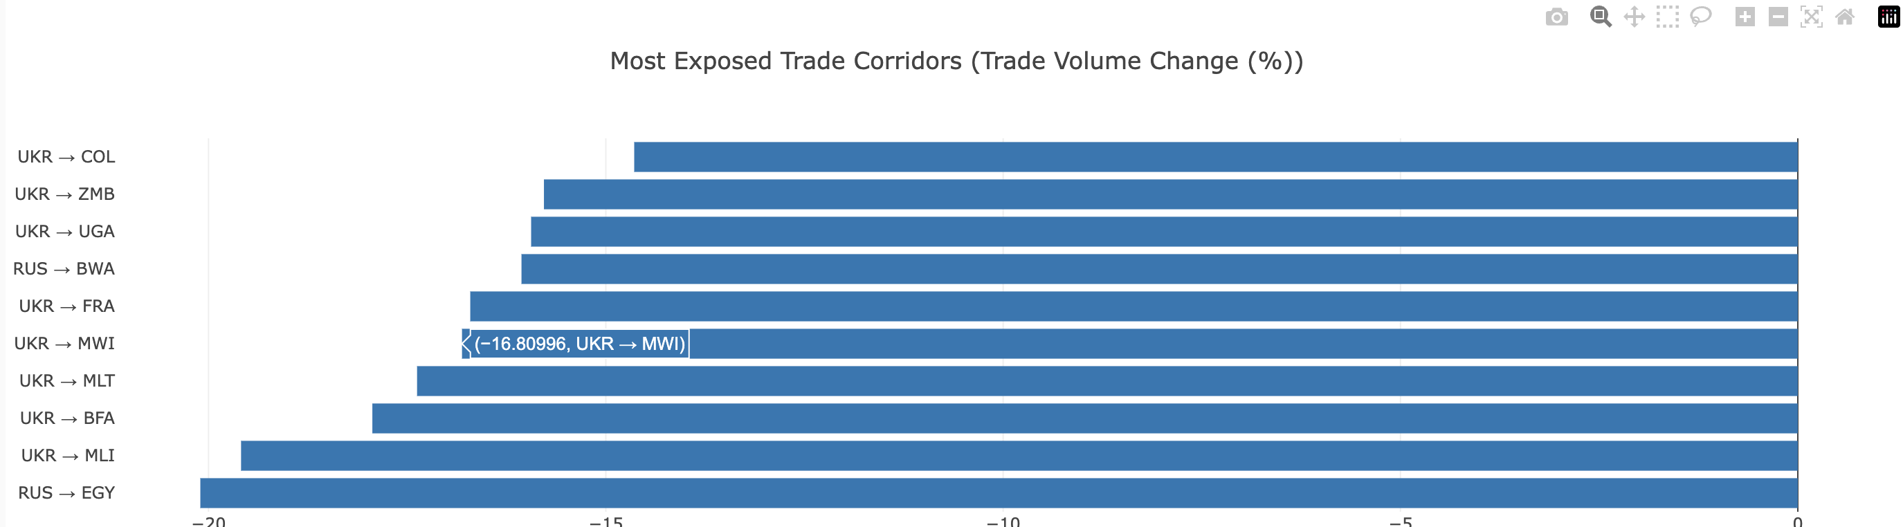
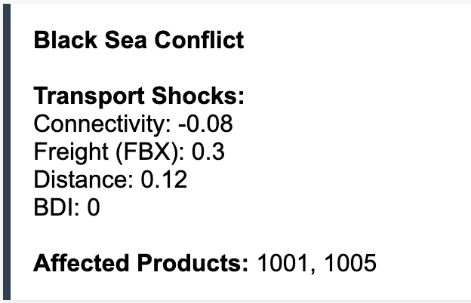
Case based Simulation
This simulation developed to quantify the sensitivity of the models with apply stress/shocks to the predicting variables
Black sea conflicts
EU ETS
La Nina

Slide 16
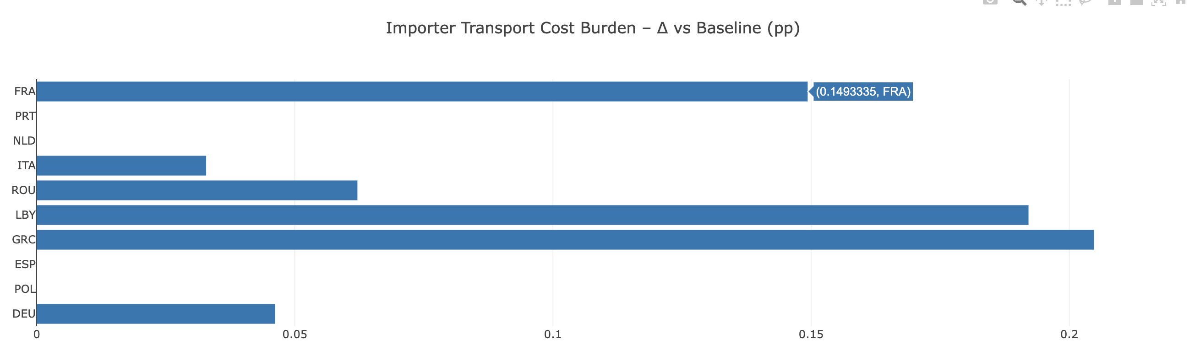
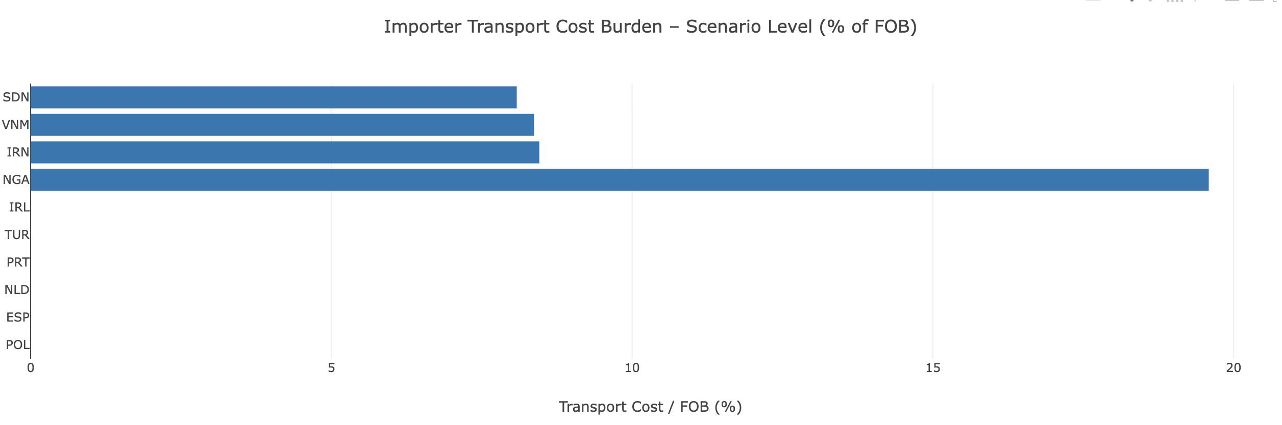
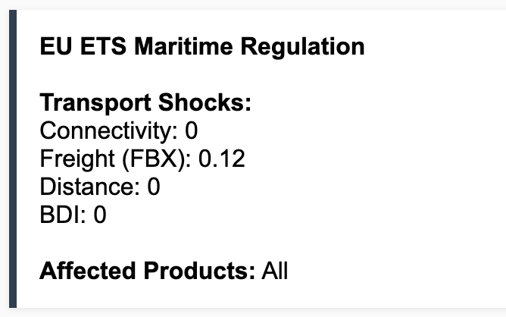
Case based Simulation
This simulation developed to quantify the sensitivity of the models with apply stress/shocks to the predicting variables
Black sea conflicts
EU ETS
La Nina

Slide 17
Conclusion & Implications
1. Correlation of Food Security and Maritime Transport.
$$ln\left(\text{Sea} \text{Cost} \text{per} \text{ton}ijc\right)=α_{i}+δ_{j}+β_{1}\ln\left(\text{Dist}ij\right)+β_{2}\ln\left(\text{FBX}\right)+β_{3}\ln\left(\text{BDI}\right)+β_{4}\text{Conn}ij+β_{5}\text{BulkShare}ijc+ε_{ijc}$$
$$ln\left(Sea Trade_{ij}\right)=β_{0}+β_{1}ln\left(GDP_{i}\right)+β_{2}ln\left(GDP_{j}\right)+β_{3}ln\left(sea_cost_per_ton\right)+β_{4} (Calorific Needs) +β_{5} (Production)+{…..ε}_{ij}$$
Transport Cost
Food security
2. Transport cost and Trade Flow Forecast model for Future Projection/Simulation

Slide 18
Limitations & Future Research
Billateral Trade Data period 2017-2021, Aggregate by Mode, Aggregate by Country Level
Cereals trade, and Trade by Product for Forecast Model observation.
The transport proxy predictors are based on aggregated value and generalized over countries/Corridors.
The Forecast projection and segmentation analysis is limited to bilateral country flow, with generalize shocks assumption and analysis.
A longer and updated data observation, for Transport cost Trade
Cereals trade and breakdown to Cargo-type level for Forecast Model observation.
More Specific panel and transport-maritime transport predictors, such as Origin /Destination Port efficiency, maritime traffic, and Freight Rate/Charter Rate per Corridor
Include port-to-port flow (Export Port-Transhipment-Import Port), AIS data of Ship movement along choke-point.
Detail Policy/Risk analysis from the Forecast Projection

